Slide 1
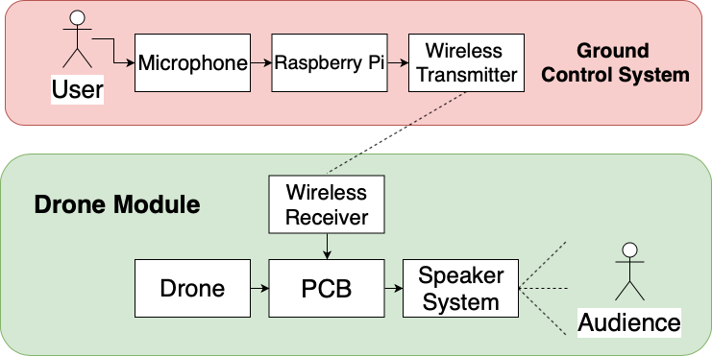
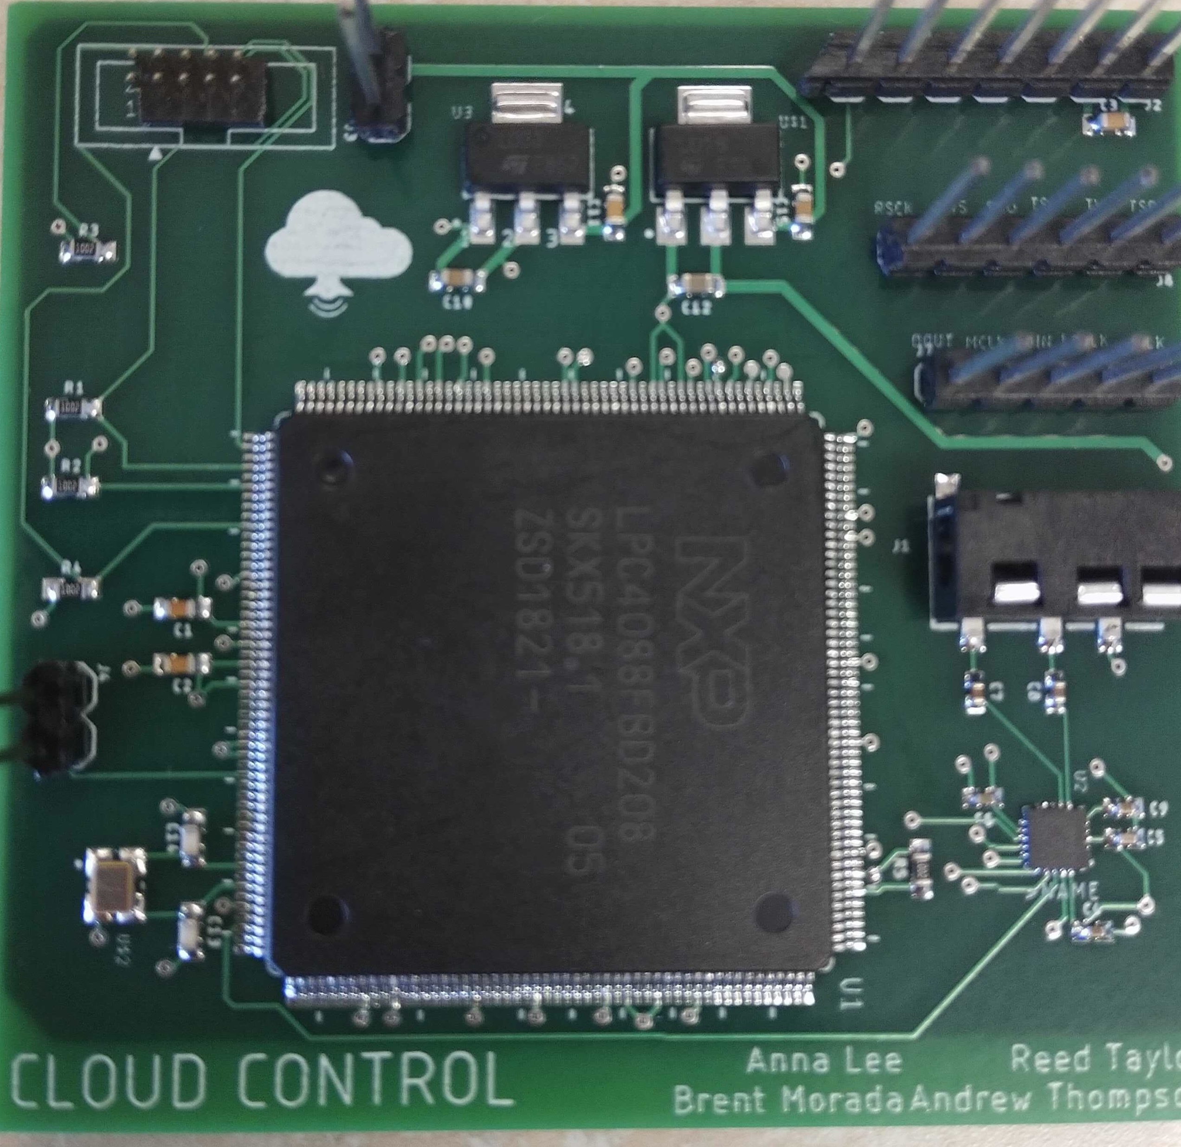
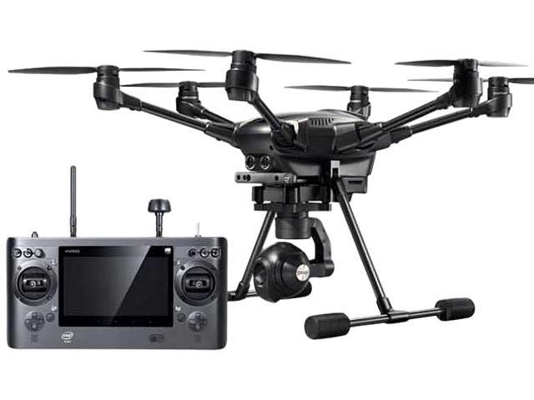
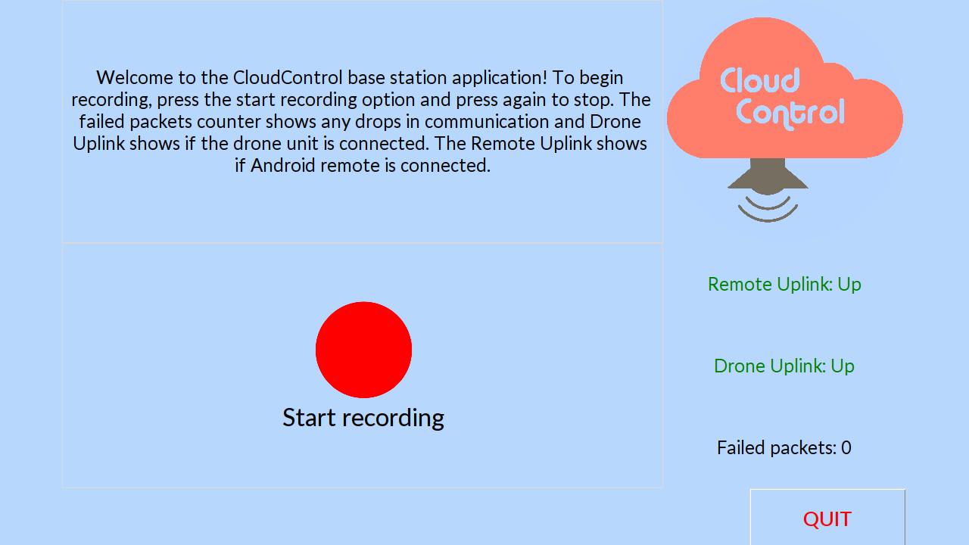
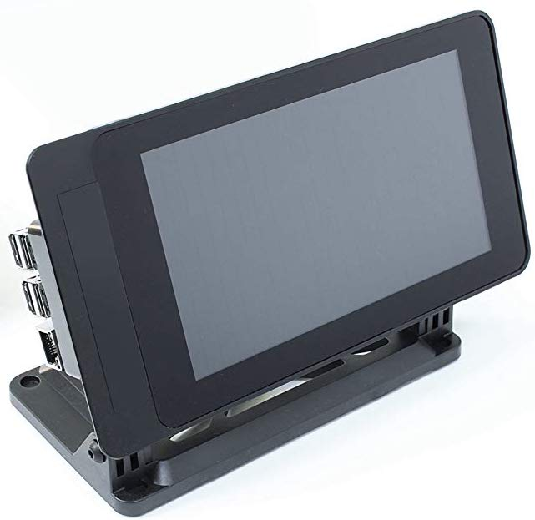
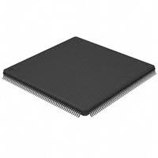
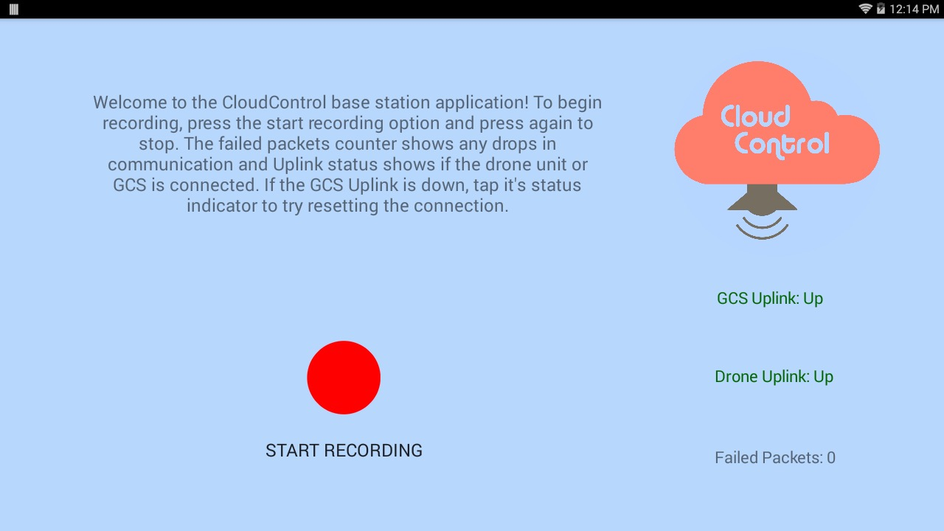
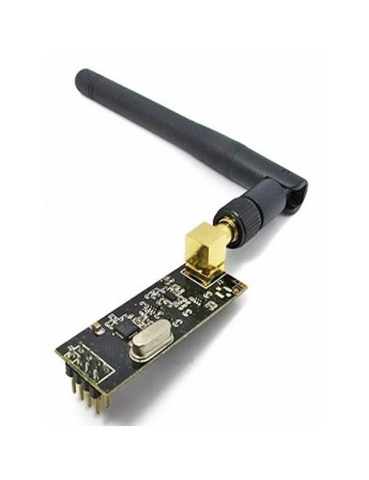
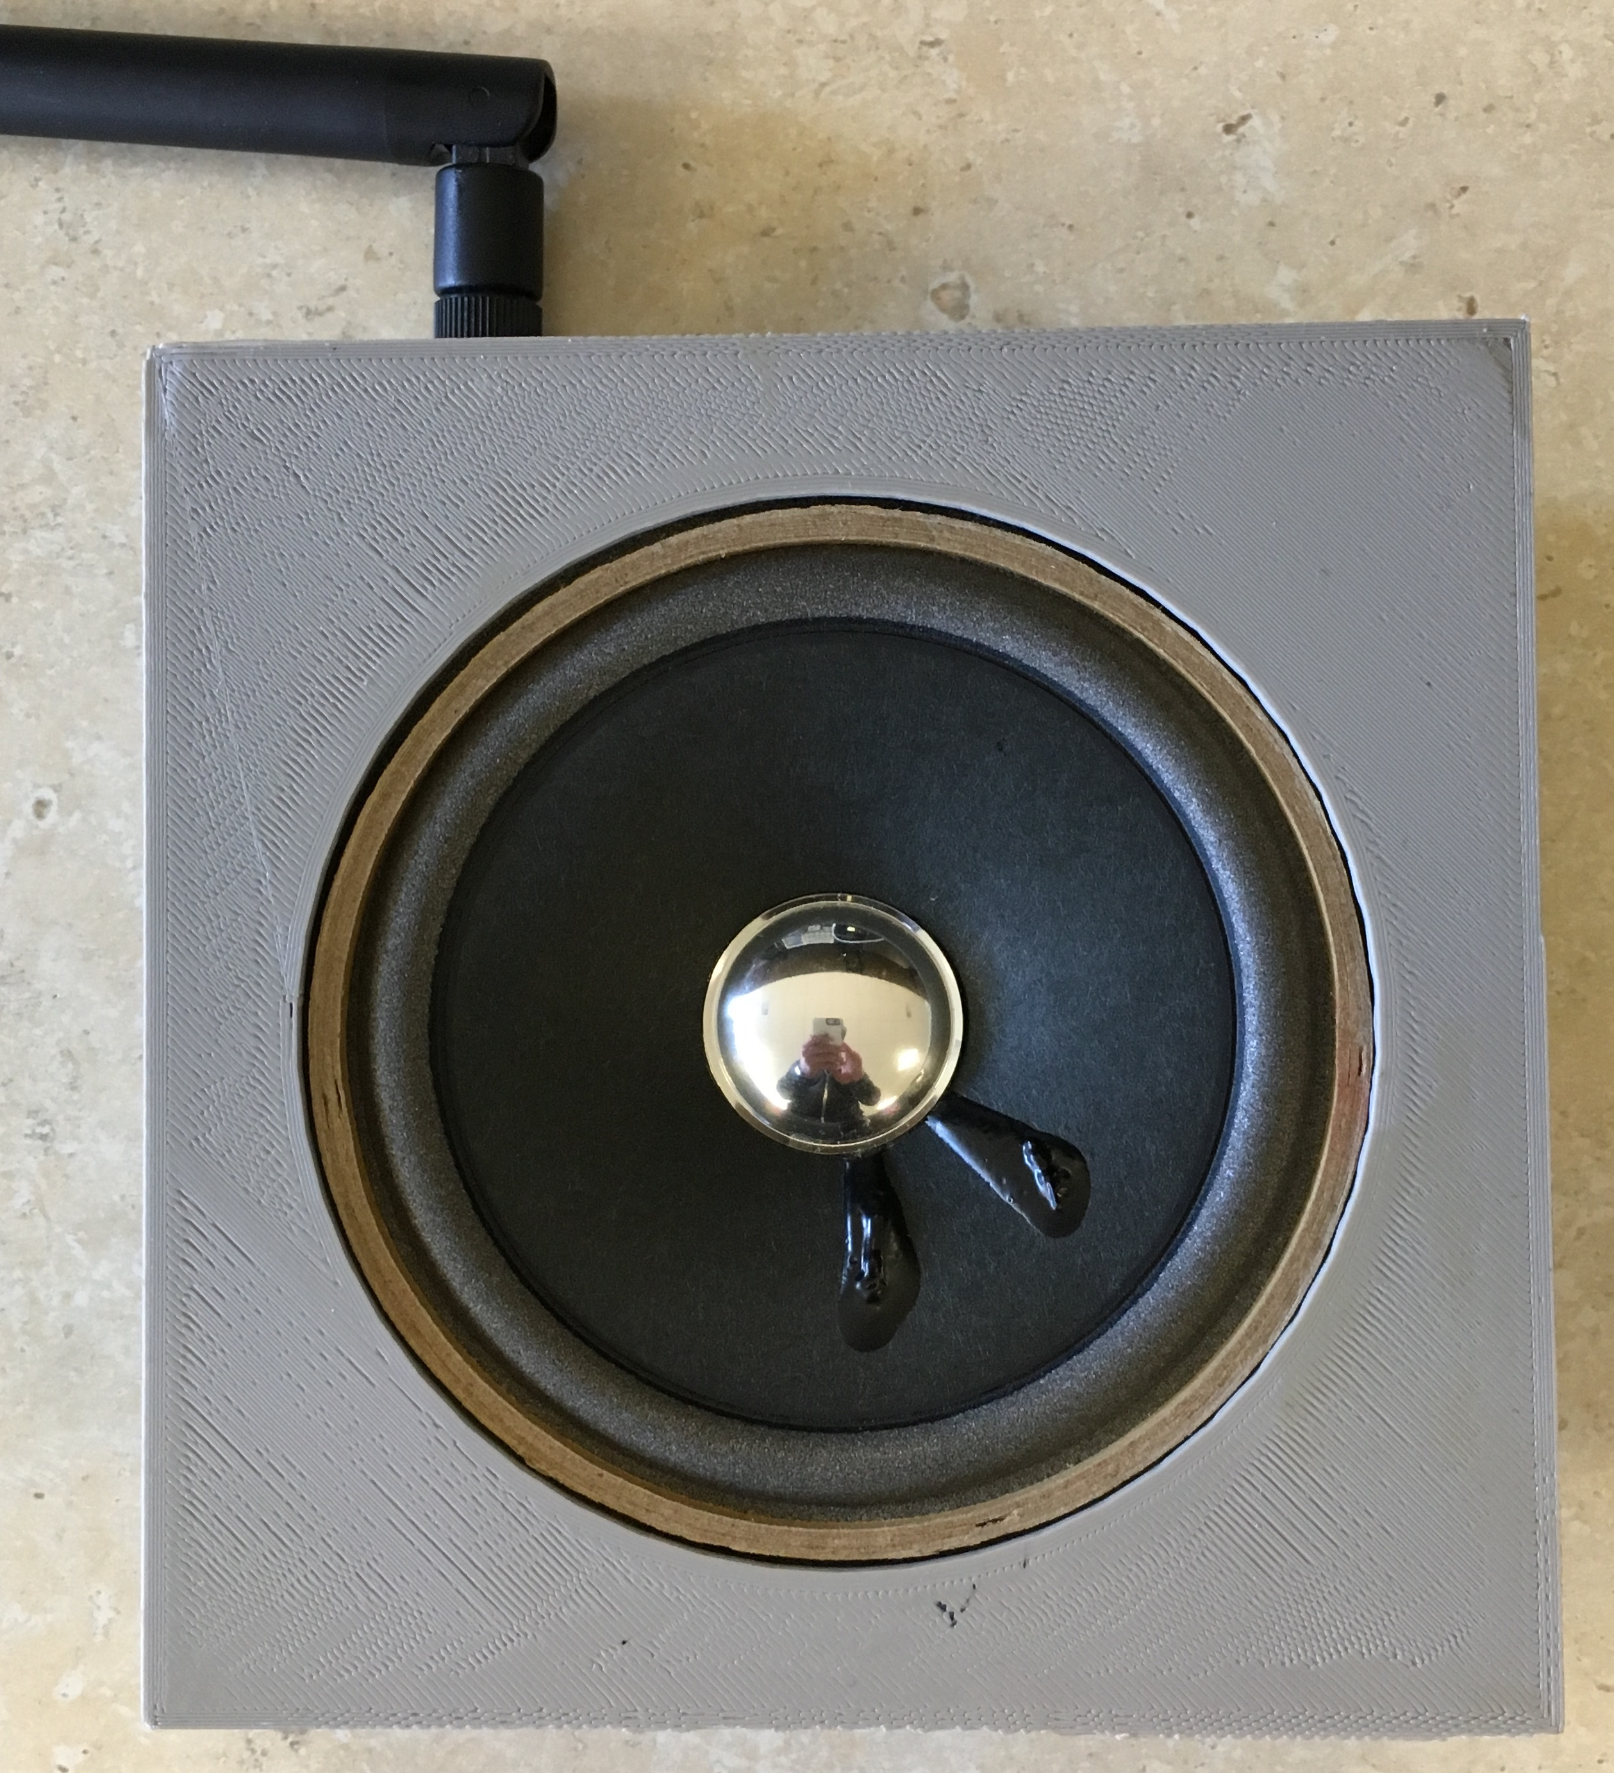
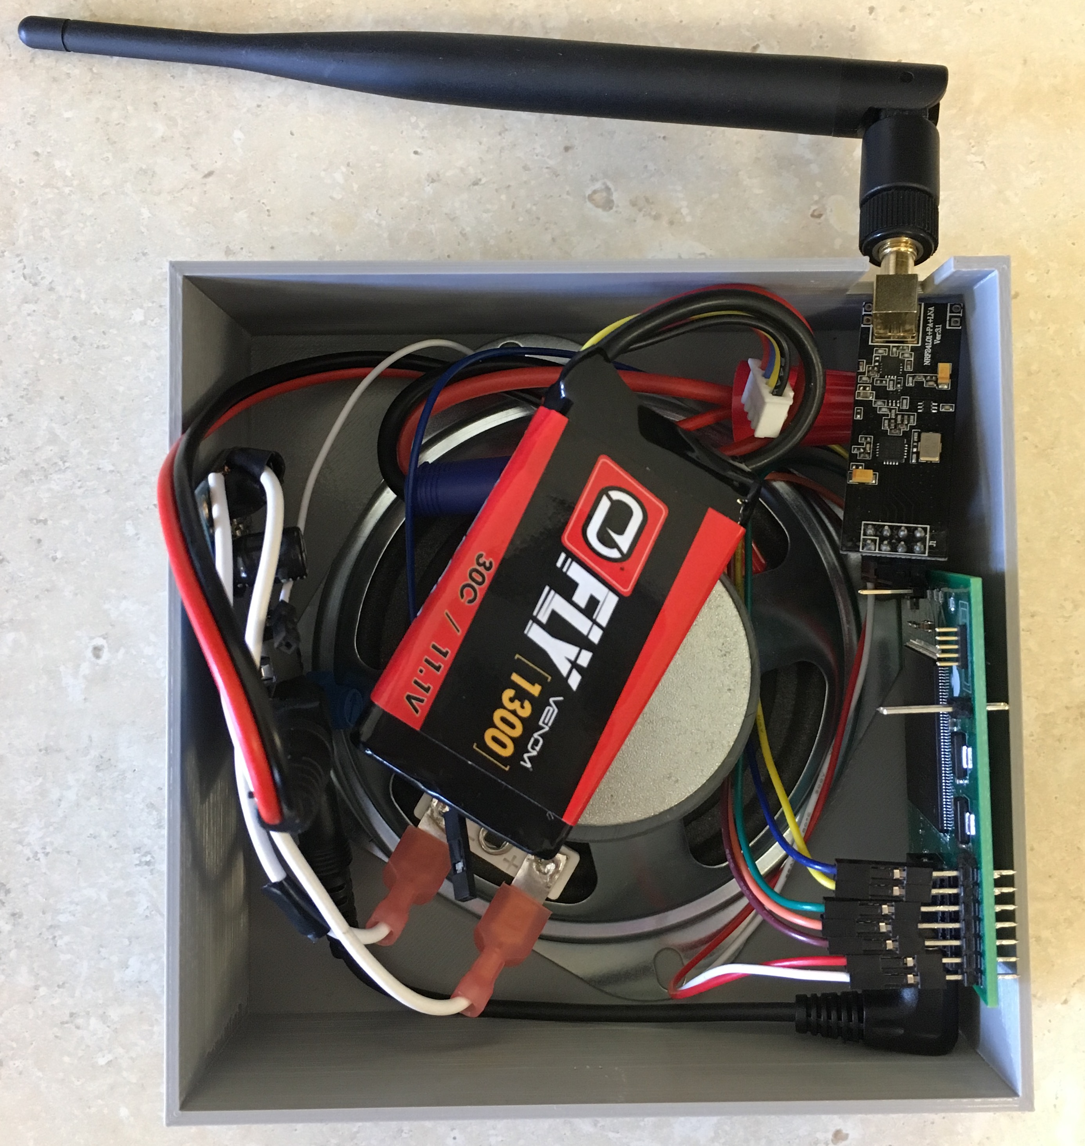
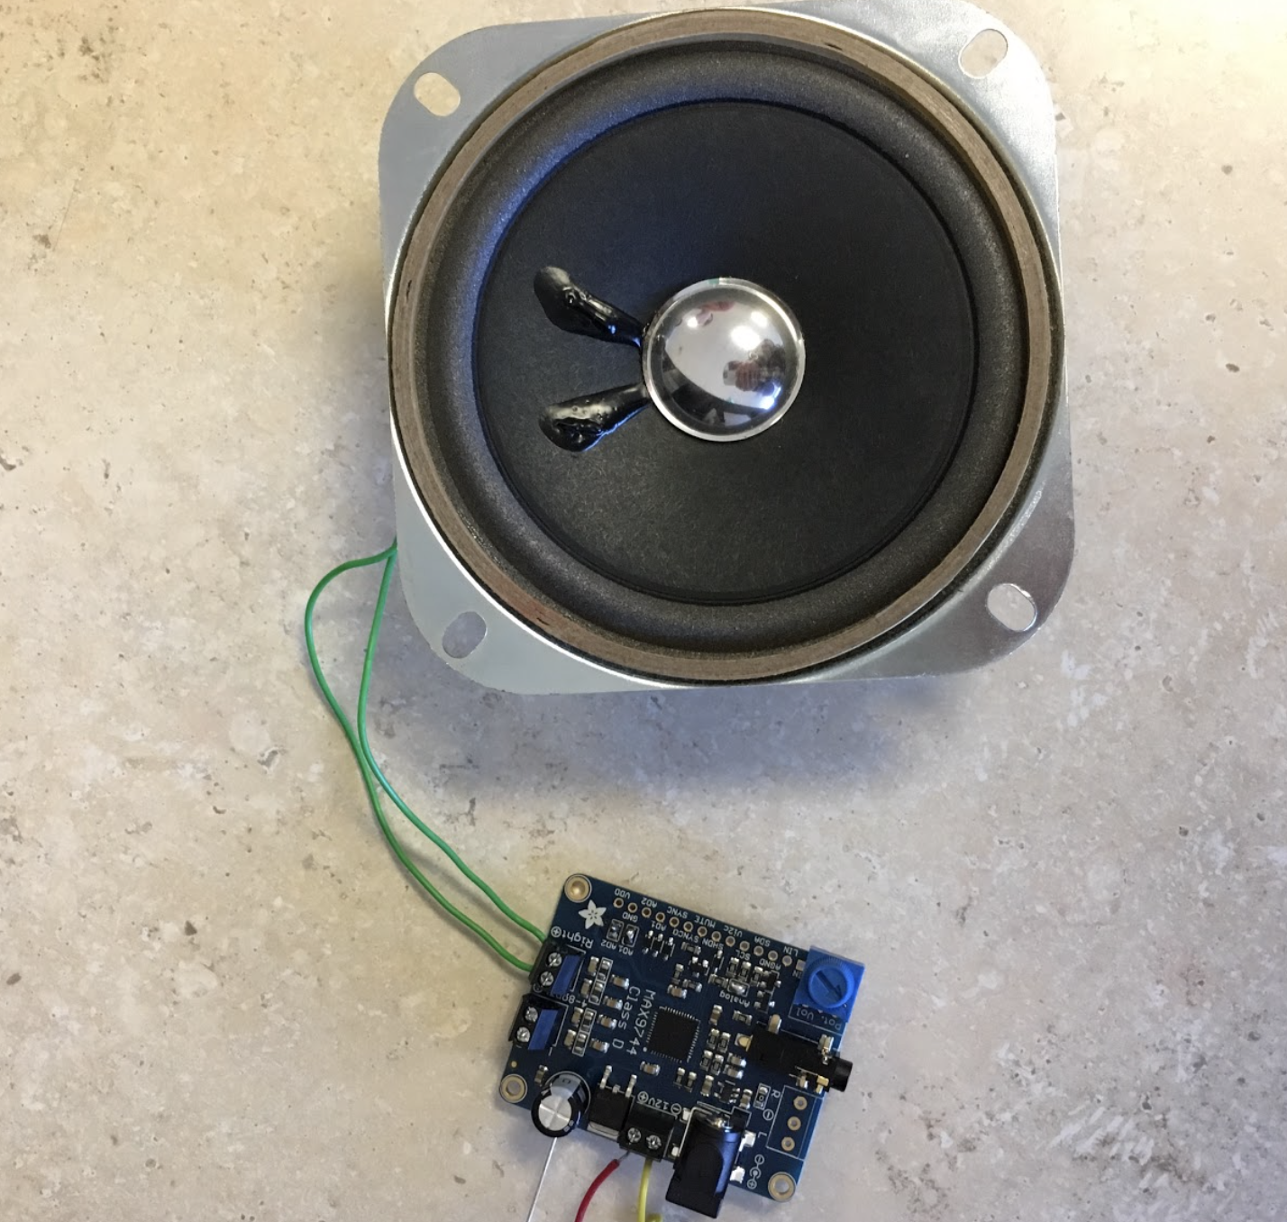

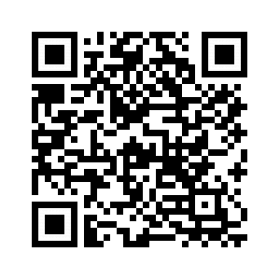

Cloud Control
Andrew Thompson | Reed Taylor| Brent Morada | Anna Lee
Background
System Block Diagram
Printed Circuit Board
Communicating with groups of people during an emergency situation is an extremely important and challenging task. The Cloud Control project aims to relay messages from a ground control system to a target audience under a drone without being physically present.
Ground Control System:
User interface running on Raspberry Pi touch screen with a microphone
f
Drone Module:
PCB with speaker system mounted on drone
Drone
User Interface
Critical Hardware Components
Yuneec Typhoon-H:
Hexacopter drone with lifting capacity of 1 lb.
Quiet for a drone of this size (comparable volume to a quadcopter)
Ground Control System
Raspberry Pi 3B+
Touch screen user interface
Microphone for recording
LPC4088 Microcontroller
Main chip on PCB
Receives audio samples from NRF and passes them to codec
NRF24 Wireless Module
Connected to ground control and drone module
Sends/receives digital audio samples
Final Product
Software Design
Ground Control System:
Python user interface running PyAudio which passes binary audio samples to be sent over the NRF module
Drone Module:
NRF receives the binary audio samples and passes them to the microcontroller
The microcontroller passes the samples to the audio codec which converts and outputs an analog signal to the speaker system
Audio Codec
Converts digital audio samples and outputs them as an analog signal
Speaker System
Receives analog signal, amplifies it, and outputs it pointing directly down from the drone towards the audience
Acknowledgements:
Special thanks to Phil Tokumaru, Yogananda Isukapalli, Brandon Pon, and Carrie Segal.

